Slide 1
Outline
2
Website and app development
Information architecture
Navigation design

Slide 2
Website and App Development
3
Website design with clear objectives
Gradual increase in content
Navigation is the key concern
Apps are specific
Navigation design (for apps) is relatively easier
Responsive design

Slide 3
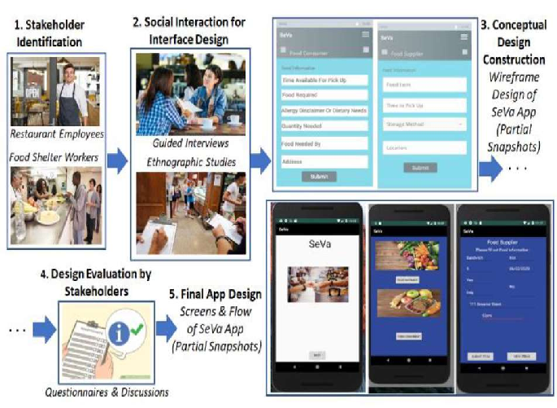

Slide 4
Information Architecture of Apps and Websites
4
How content is classified and organized
Structures, categories, and collections
Different objectives and users
Challenging task

Slide 5
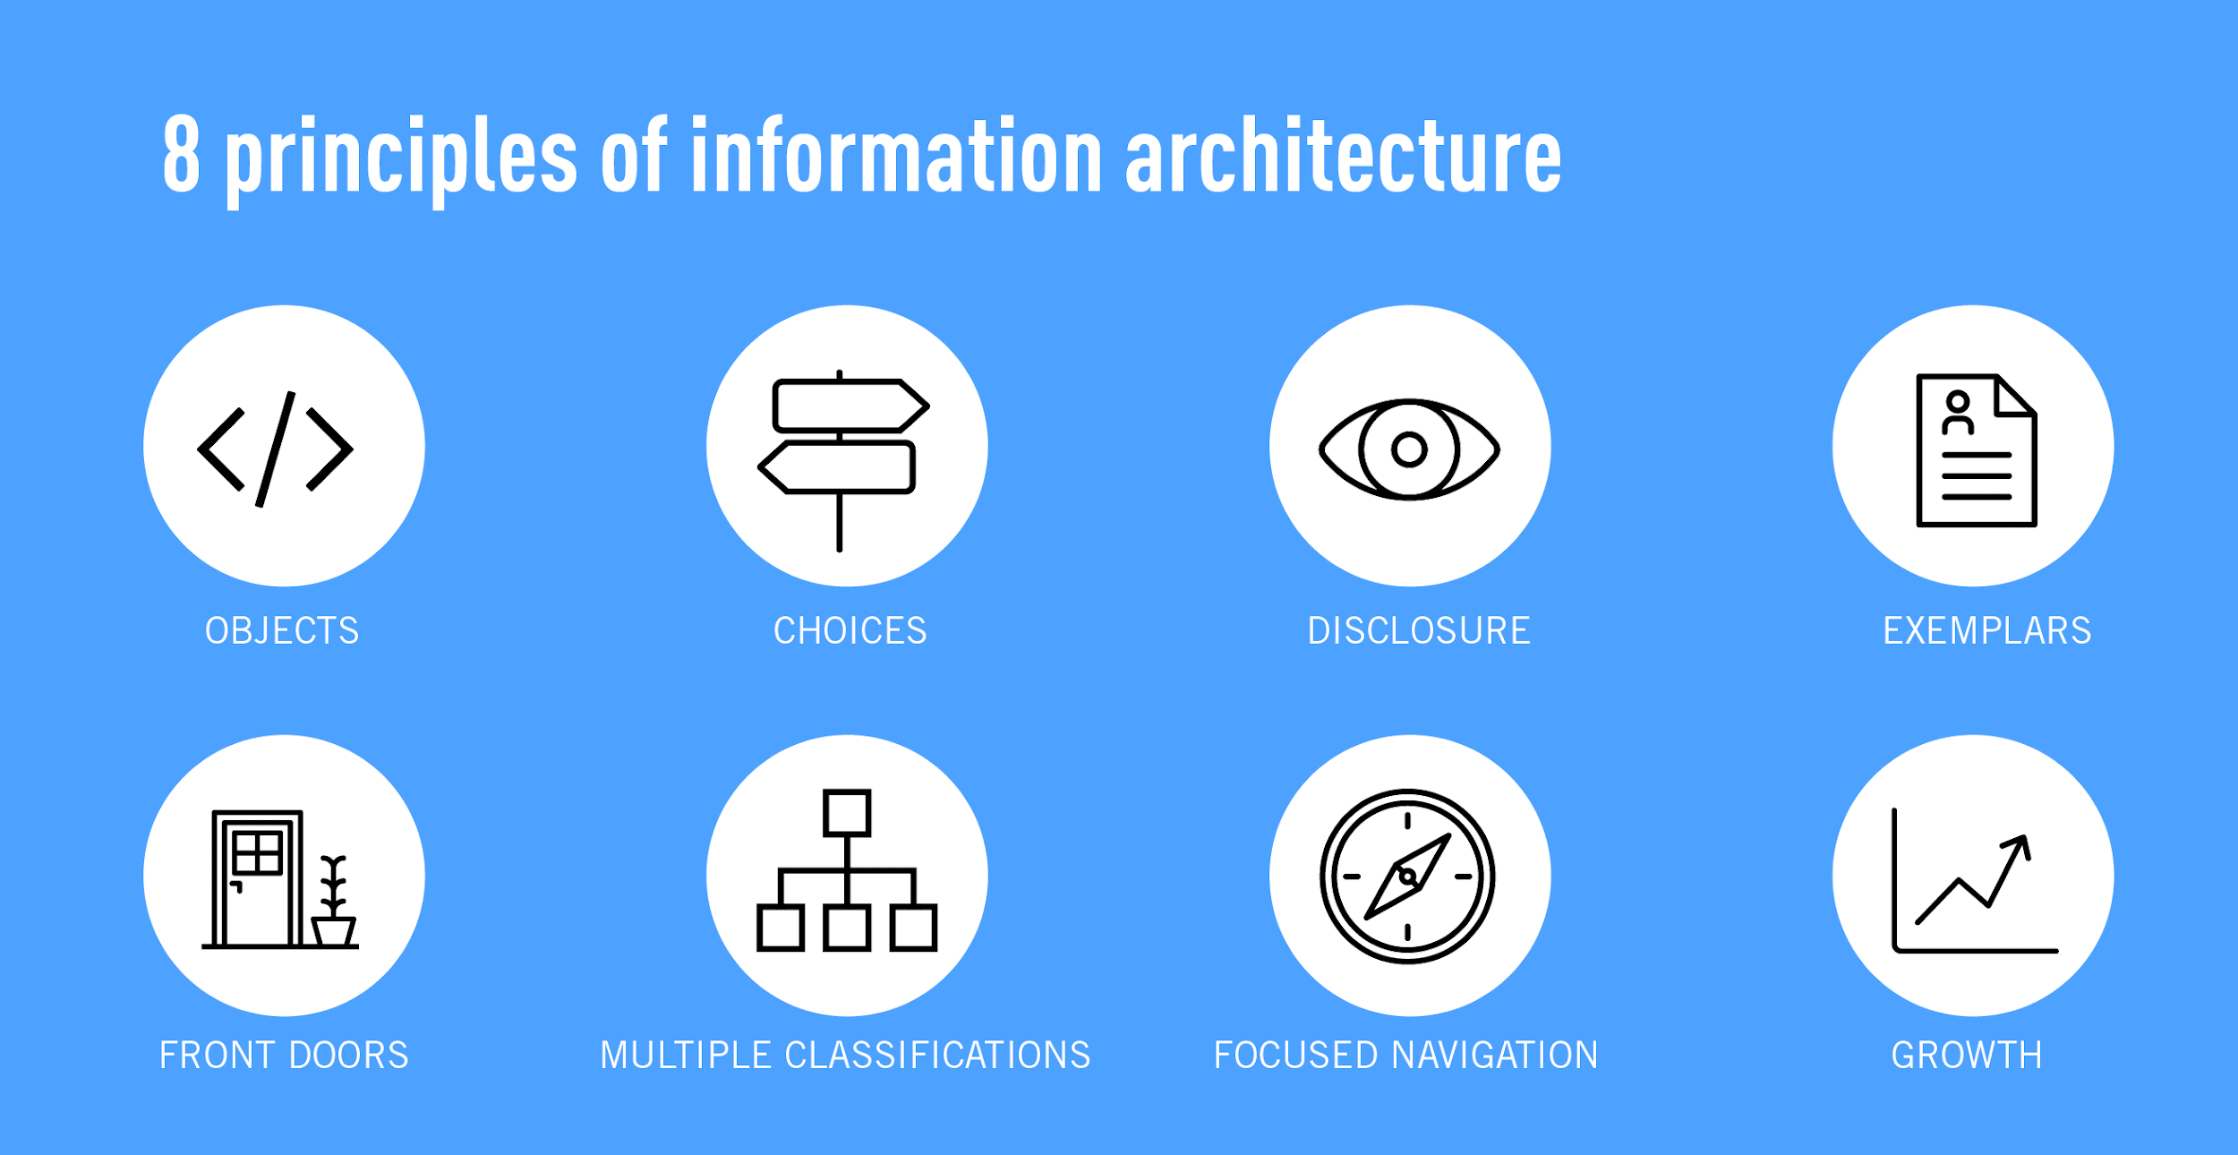

Slide 6
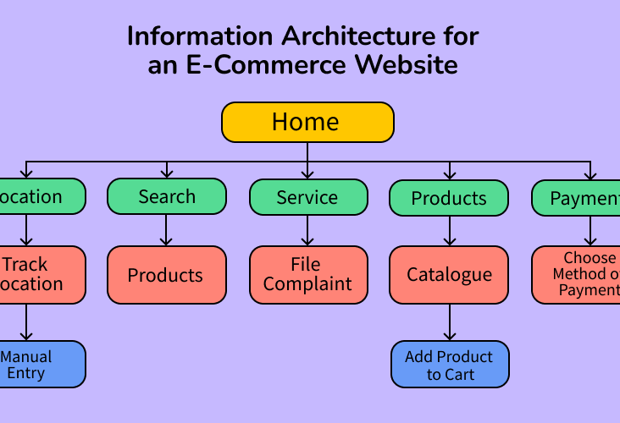

Slide 7
Classification Schemes
5
Also called ontology
Choice of ontology is critical
Exact schemes
🞑 Alphabetical, chronological and geographical
Ambiguous schemes
🞑 Subjective
Alphabets, locations, time, continuums, numbers, categories, randomness

Slide 8
Faceted Classification
6
Website can be described in terms of dimensions, facets, and values
Consider a travel website
🞑 Dimensions: Cars, flights, hotels
🞑 Facets: price, origin/destination, locations
🞑 Values: Name of city and airport
Suitable for small and clearly defined spaces

Slide 9

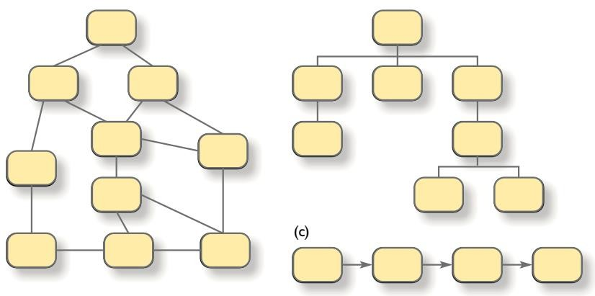
Organizational Structures
7
Different structures are possible
Hierarchical structure
upside-down tree
Network structure
Sometimes confusing
Sequence structure
Straightforward task
Figure Source: Designing User Experience, D. Benyon, 4th ed. P. 352

Slide 10
Metadata
Data about the content
Used by search engines
Three types of metadata
Intrinsic
--- Technical details
Administrative
--- Author name, revision
Descriptive
--- Classification
8

Slide 11

Navigation Design
9
navigation support :
searching mechanisms
Expert vs novice users

Slide 12
Labelling
10
Internal / external links, headings, subheadings
Text and iconic labels
Unambiguous vocabulary
🞑 Products vs items
Navigation support
🞑 Signs and labels
🞑 Global navigation bar
🞑 breadcrumbs

Slide 13
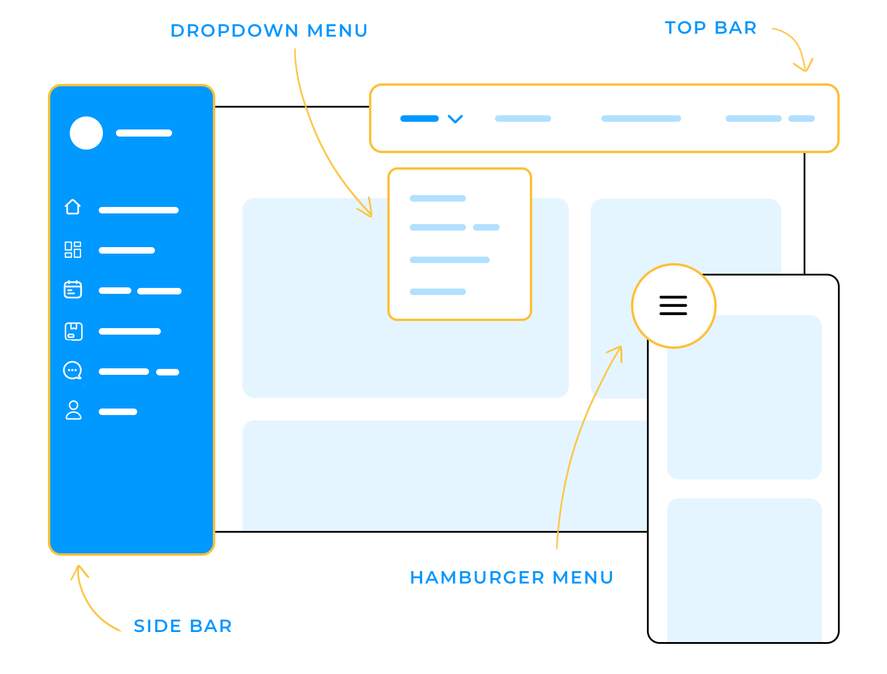

Slide 14
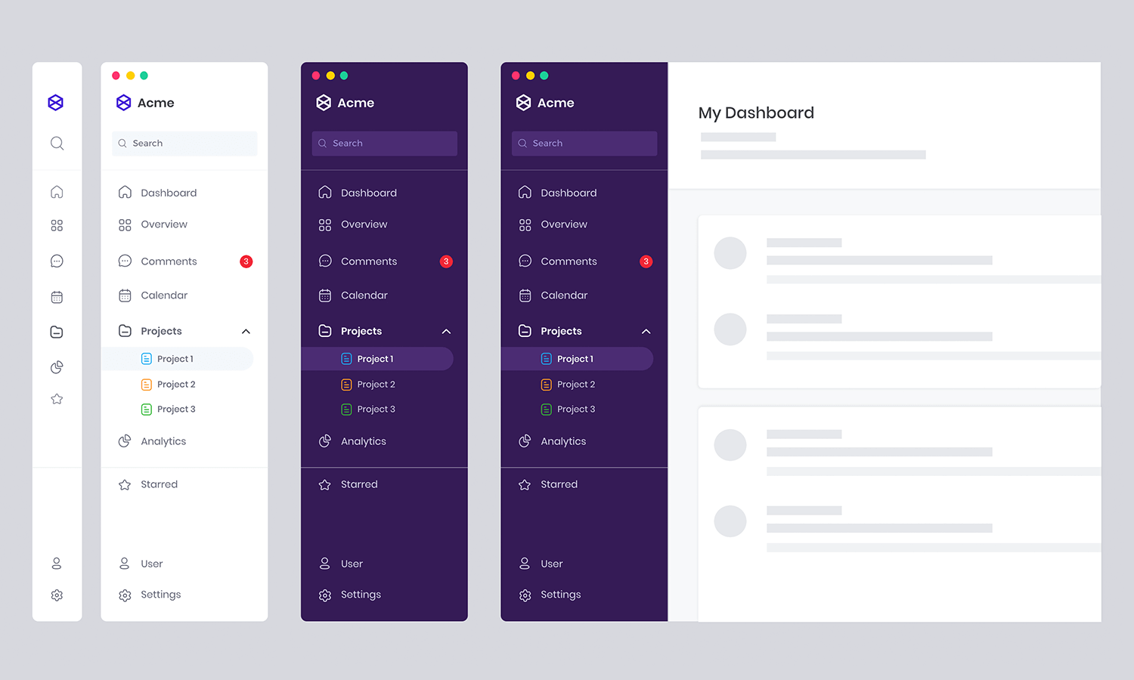

Slide 16
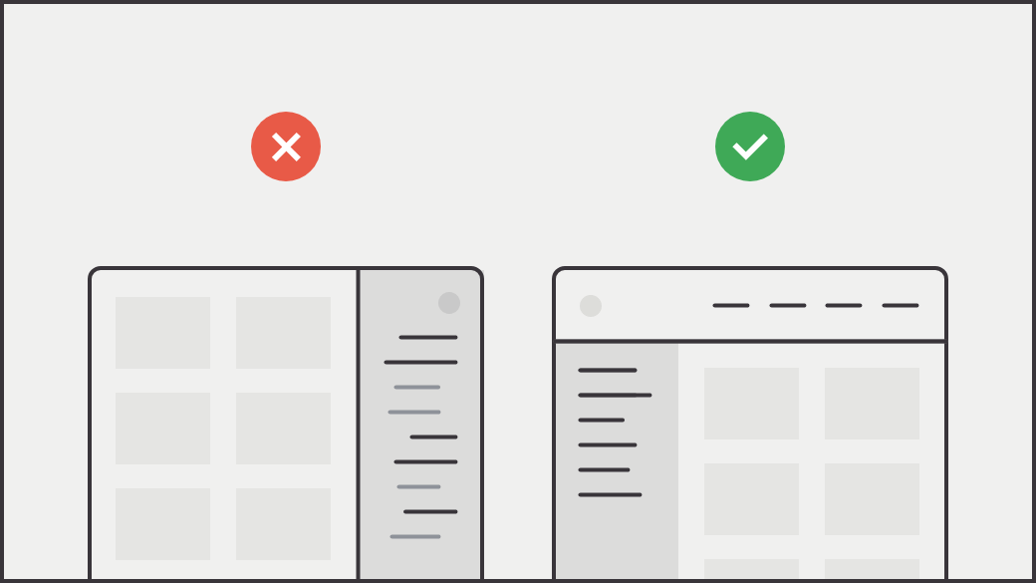

Slide 17
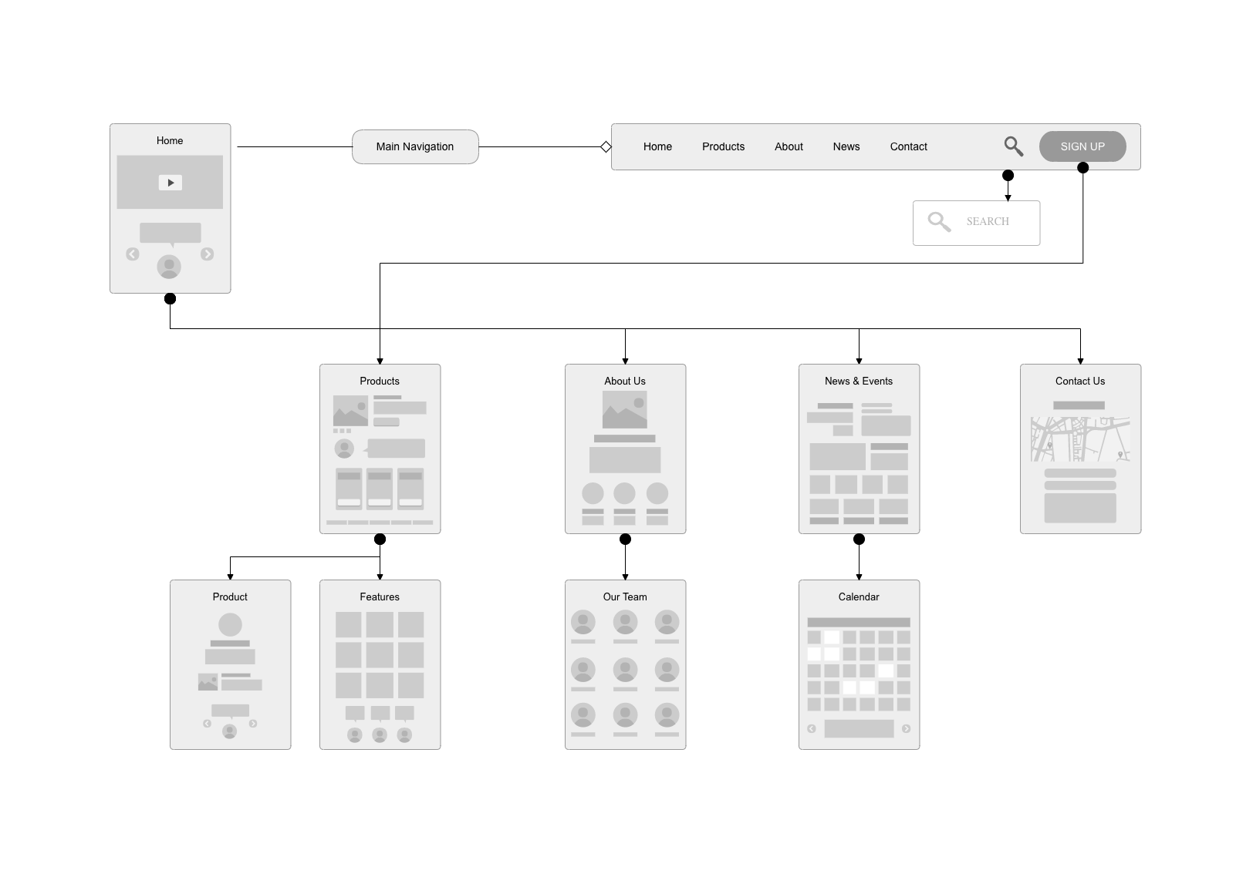

Slide 18
Searching
11
Significant feature of information space
Search engines
Preferred vocabulary
Problems
🞑 Types of documents to be searched
🞑 Search criteria

Slide 19
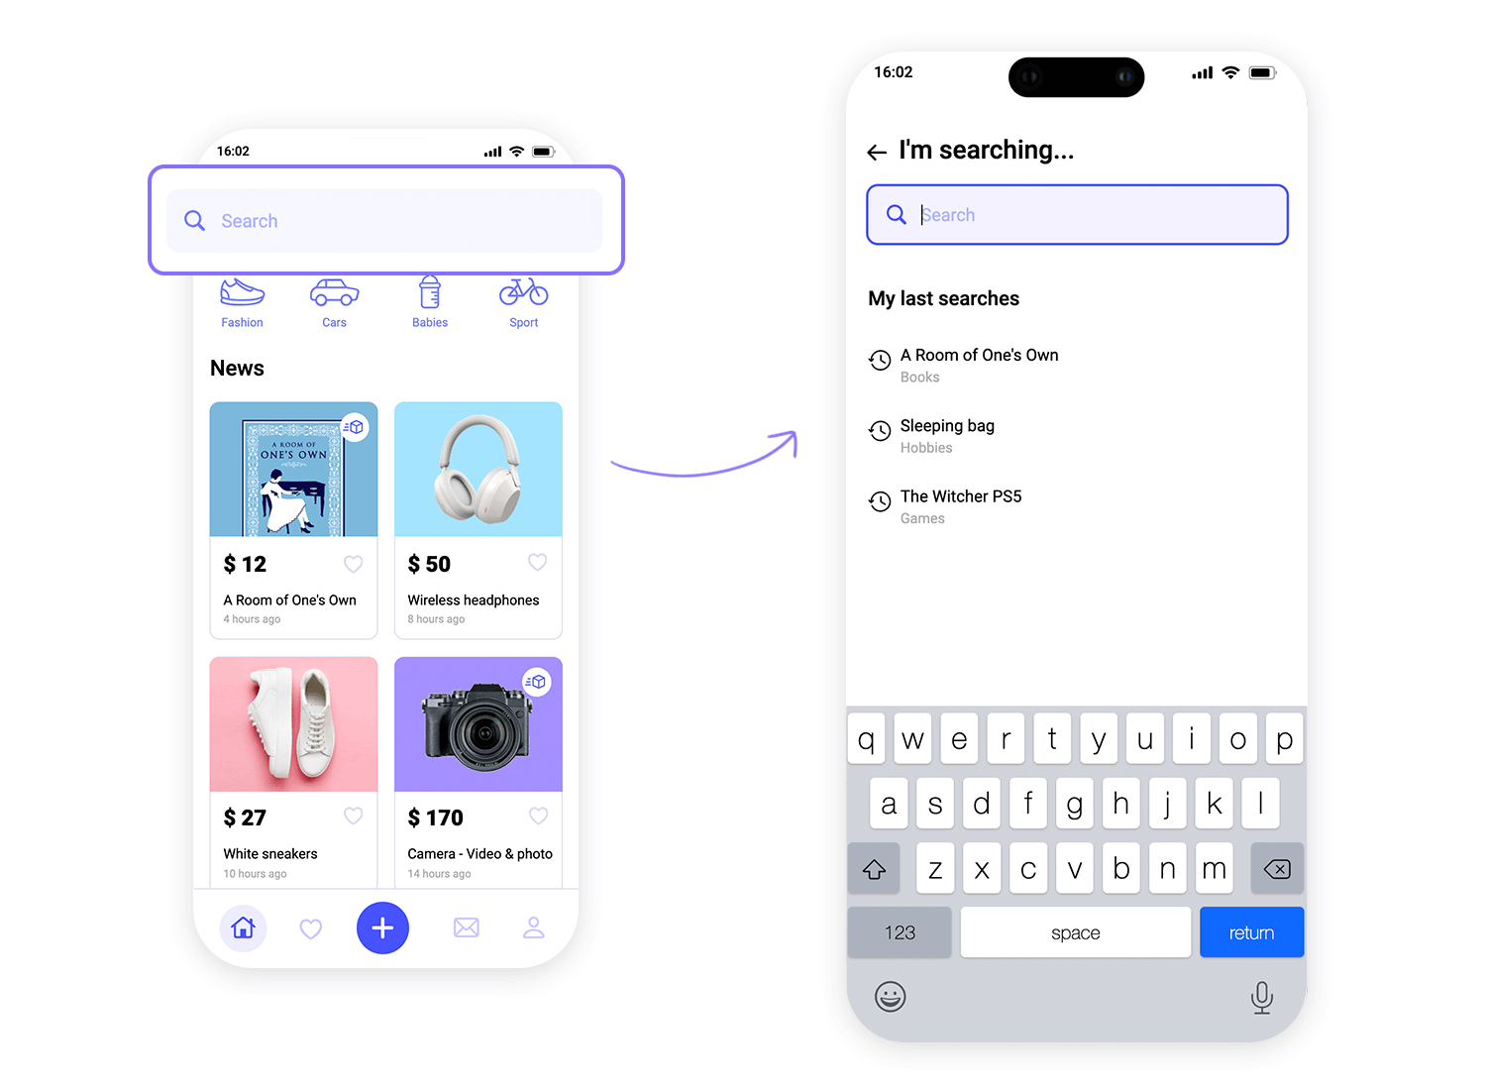

Slide 20
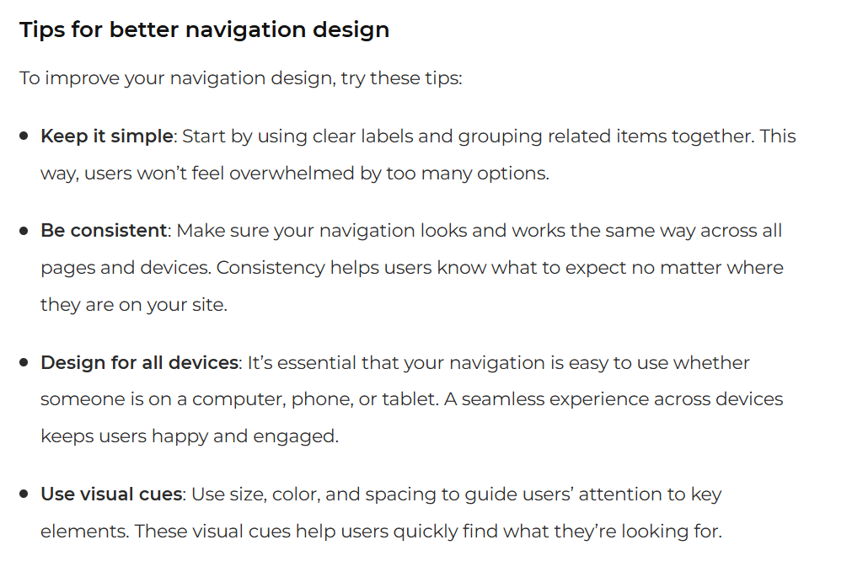

Slide 21
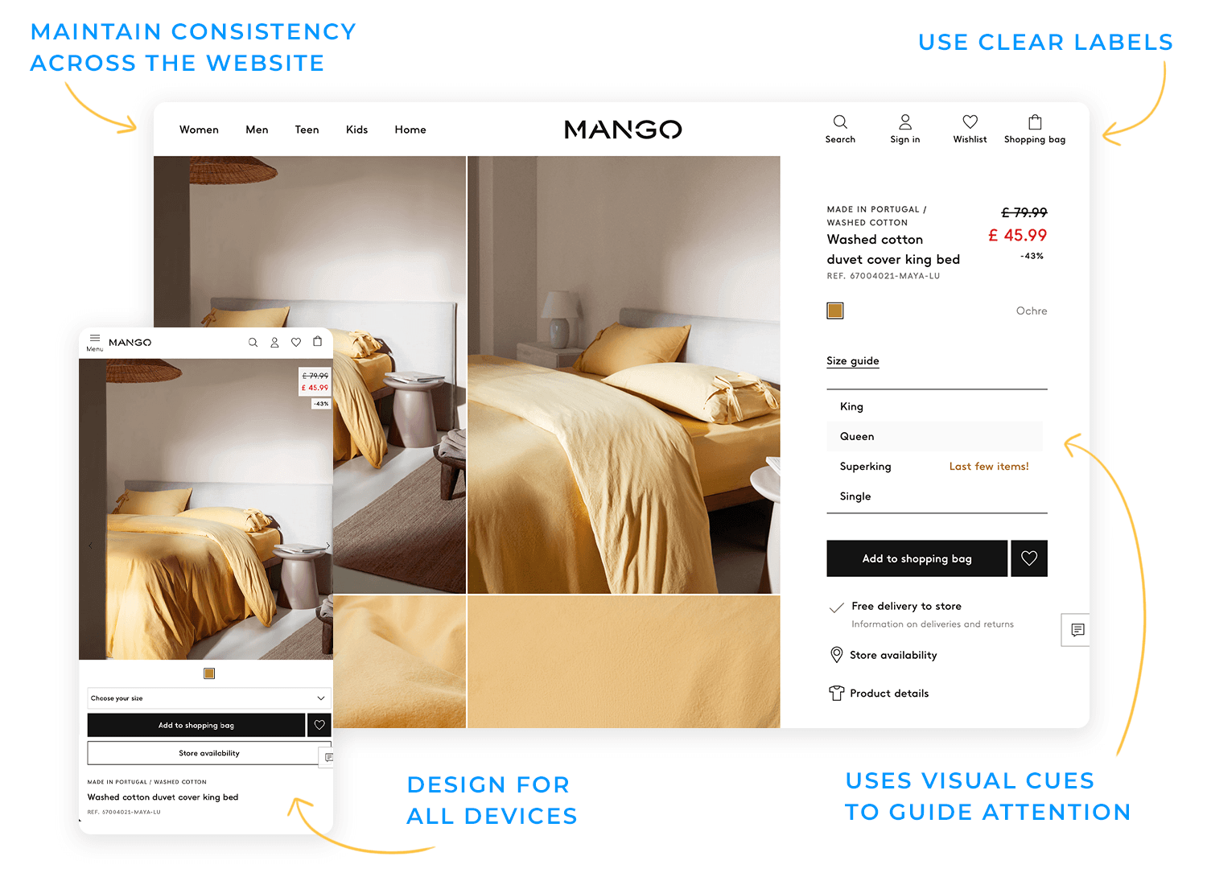

Slide 22

Notes:
https://www.justinmind.com/blog/mobile-navigation/

Slide 23
https://www.justinmind.com/download

